Slide 1
Proposal for HOOF Information System
Specter Designs

Slide 2
Specter Designs Introduction
Who we are
Our Background
Our Vision

Slide 3
Agenda
Problem Areas
Problem Areas Improvement
Benefits of Our Improvements
System Requirements
Use Case Overview
Architecture Considerations
To-Be Model Prototypes

Slide 4
Potential Problem Areas
Lack of online donation options for users, limiting the ways they can give.
Lack of central information source, increasing information gathering time
Lack of Linked Social Media engagement

Slide 5
Problem Areas Improvement
We Believe we can improve donation revenue through expanding online options.
We see ways to facilitate improvement in the grant writing process
Integrate Social media content to HOOF's management tools

Slide 6
Benefits of Our Improvements
By conservative estimates, we expect to grow HOOF individual Donations by 20%, about $550 through increased engagement and online donation options
We expect to increase Grants by a conservative estimate of 20%, about $3,600 by halving the time to write grants.
Proper Social Medial outreach might bring in another 10% conservative growth in individual donations, about $225

Slide 7
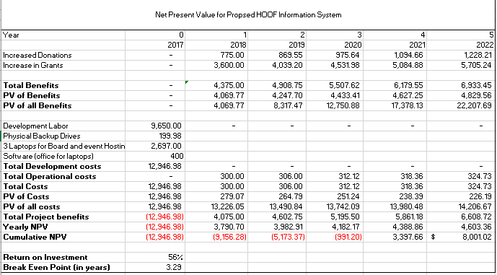
NPV Analysis of Benefits

Slide 8
System Requirements
In our full report, we have outlined many requirements our system should be able to fulfill. A summary of these requirements include:
Manage Donor information
Manage Volunteer Information
Manage Events
Information Management

Slide 9
Use Cases Overview
For these system requirements, we have also outlined a large number of use cases, also contained in the full report.
These cases outline situations the user might encounter and how our system will give the user capability in those situations.
On the next slide are examples of interactions we have prioritized fulfilling

Slide 10
High Focus Uses Examples
Use | Risk | Reasoning
Writing Grants Primary Actors: HOOF Board Members | High | Grant serve as a large potential revenue for HOOF
Organizing Events Primary Actors: HOOF Board Members | High | Events also serve to bring in revenue for HOOF
Donation Primary Actors: Donors | High | Donations again are a source of revenue that can hurt the organization if lost
Register Auction Item Primary Actors: Donors | High | Following Donations, these are important for revenue growth and therefore high risk if lost

Slide 11
Architecture Considerations
We anticipate a cloud based server will best serve HOOF's organizational needs.
We have identified several hosting providers, with options in HOOFs needs range existing in the $20-30 monthly range.
As of right now, we would like to create a WordPress site hosted by SiteGround
On the next slide we have designed a diagram of what such a system would look like

Slide 13
To-Be Model Prototype
We have designed models for key HOOF Web functions
These represent areas of high risk and importance to operations and donation income
On the next slides are models of these areas

Slide 14
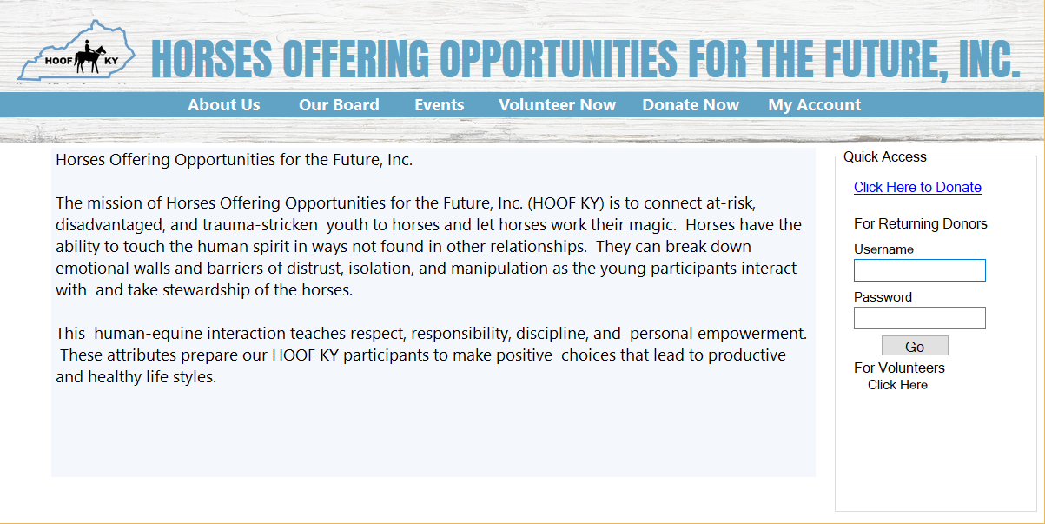

Slide 15
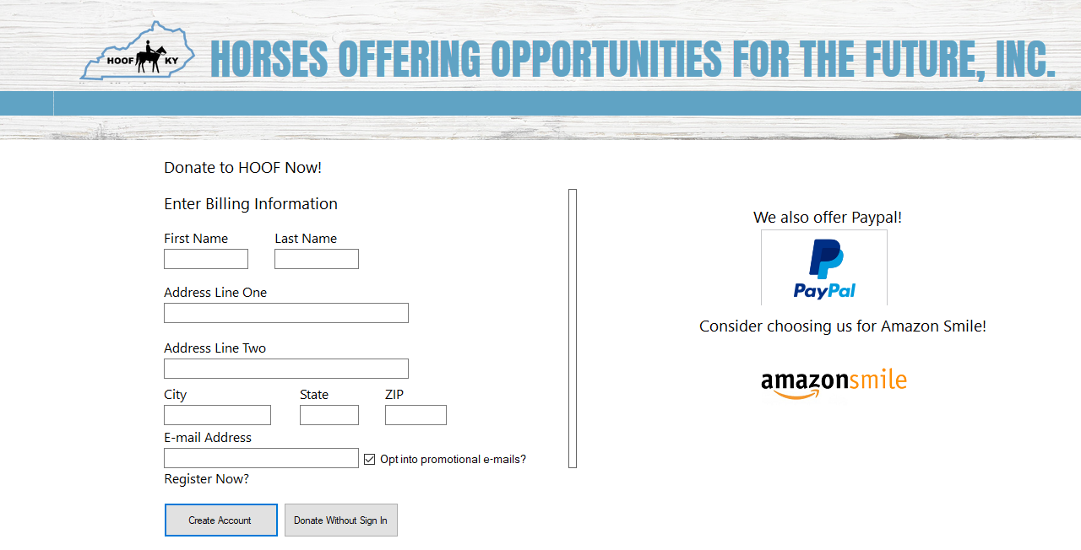

Slide 16
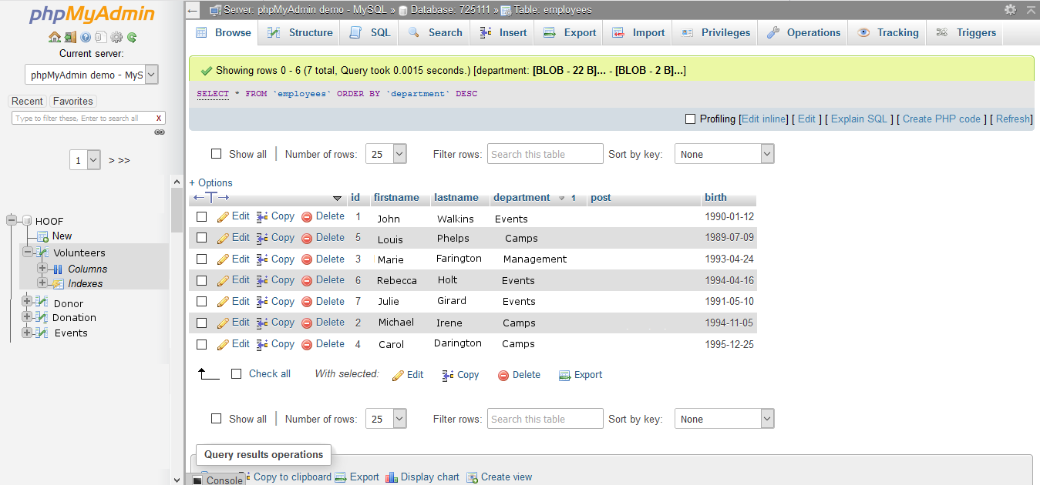

Slide 17
Conclusion
The system we propose will increase HOOF's donation revenue and grants totaling to $4,375 per year additional revenues.
Our analysis gives a 56% Return on Investment for HOOF, and the project should break even after 3.29 years.
Any Questions?

